Slide 1
Comparing Covid-19 Dynamics Across US Counties

Slide 2
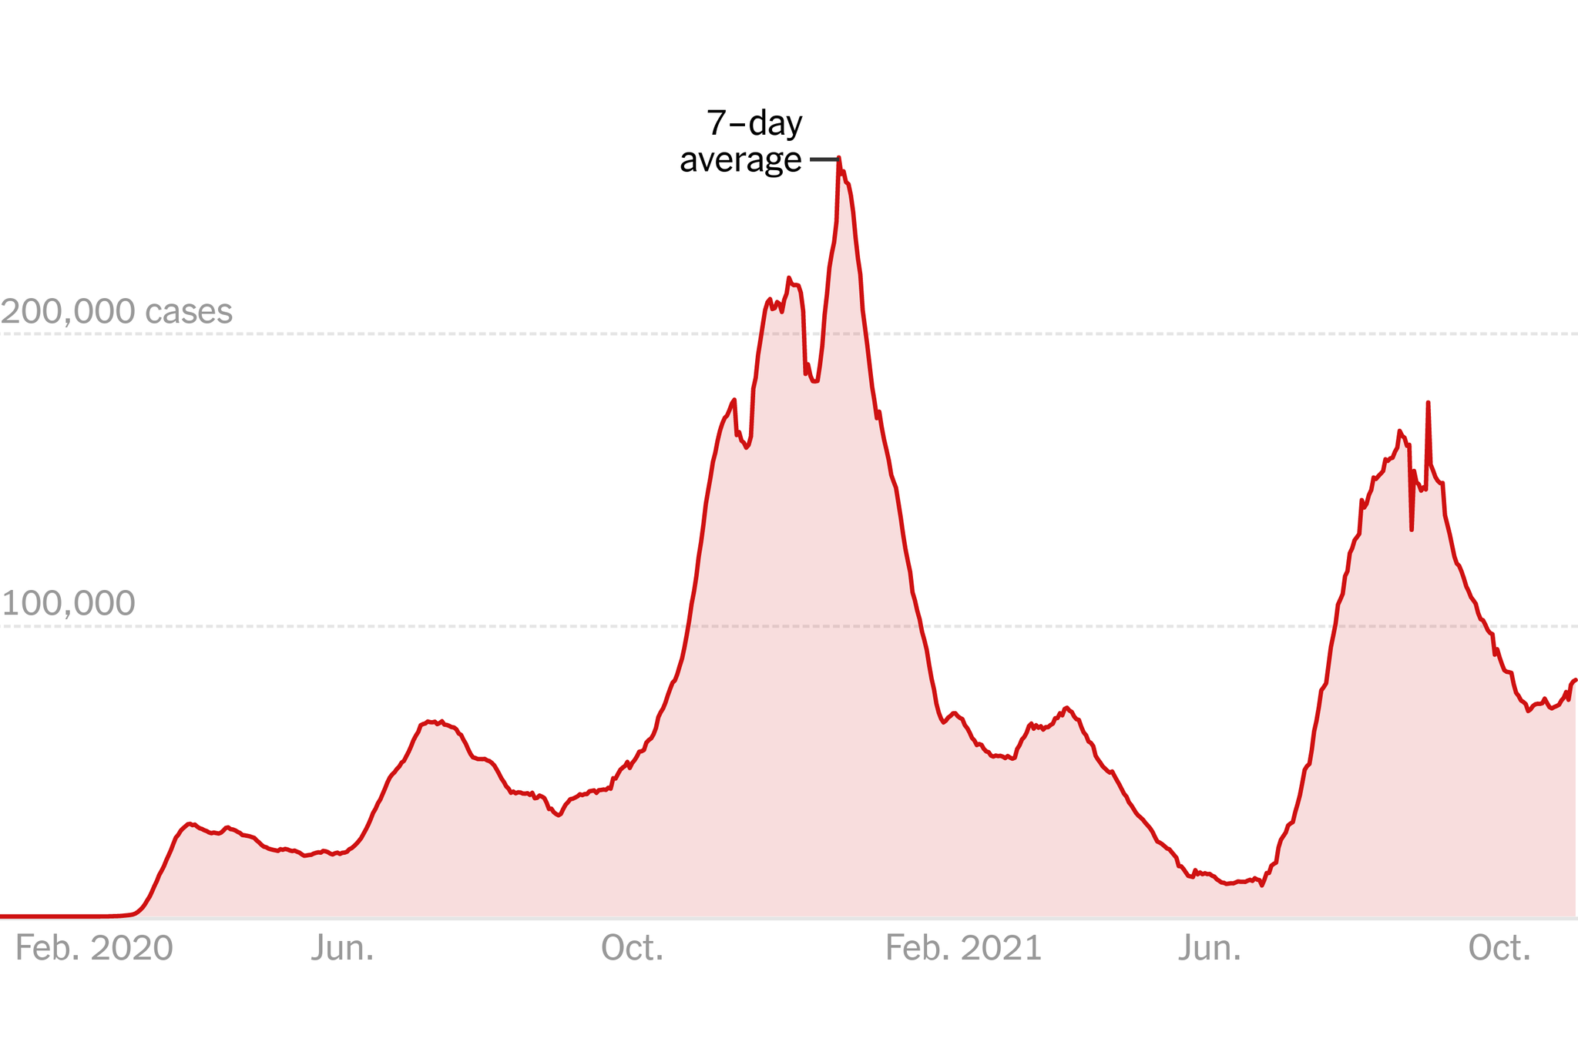
Covid - 19
First Case in US in January 2020
Vaccine became widely available in Mid-April 2021
Delta variant introduced US around June 2021
Nytimes.com

Slide 3
Why is this important?
Not much actual study into county level dynamics.
Lack of data on Urban vs Rural Populations
Expect Urban to have a higher prevalence
Help identify high risk counties

Slide 4
Data Sources
NYTimes Covid Data
Population Census Estimates

Slide 5
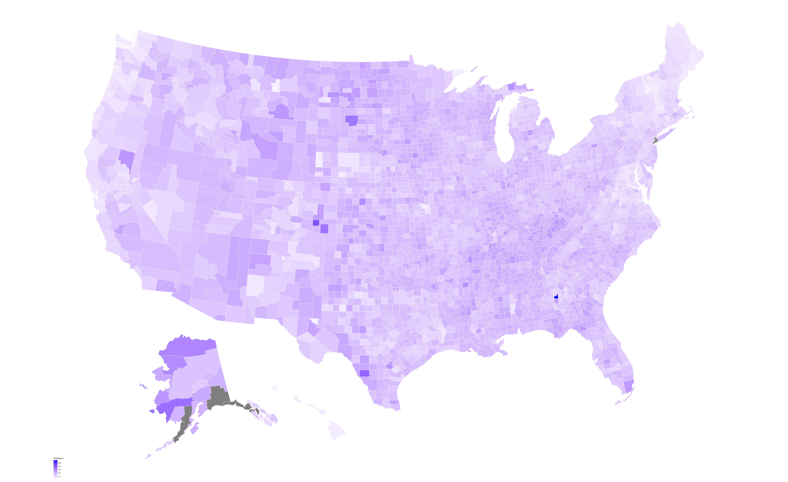
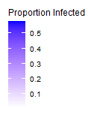

Slide 6
Map of Mask Mandates

Slide 7
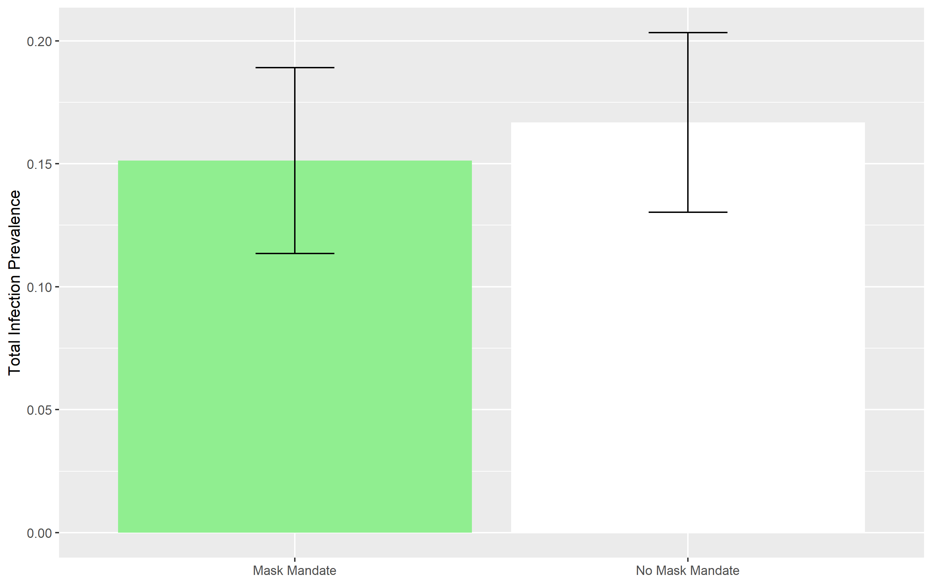
Infection Prevalence Compared to mask mandate
Notes:
p.Value = 1.5e-30

Slide 8


Urban Area:
Population ≥ 50,000
Rural:
Population < 50,000
Urban Area:
Population ≥ 50,000
Urban Cluster:
Population < 50,000
Population ≥ 2,500
Rural:
Population < 2,500

Slide 9
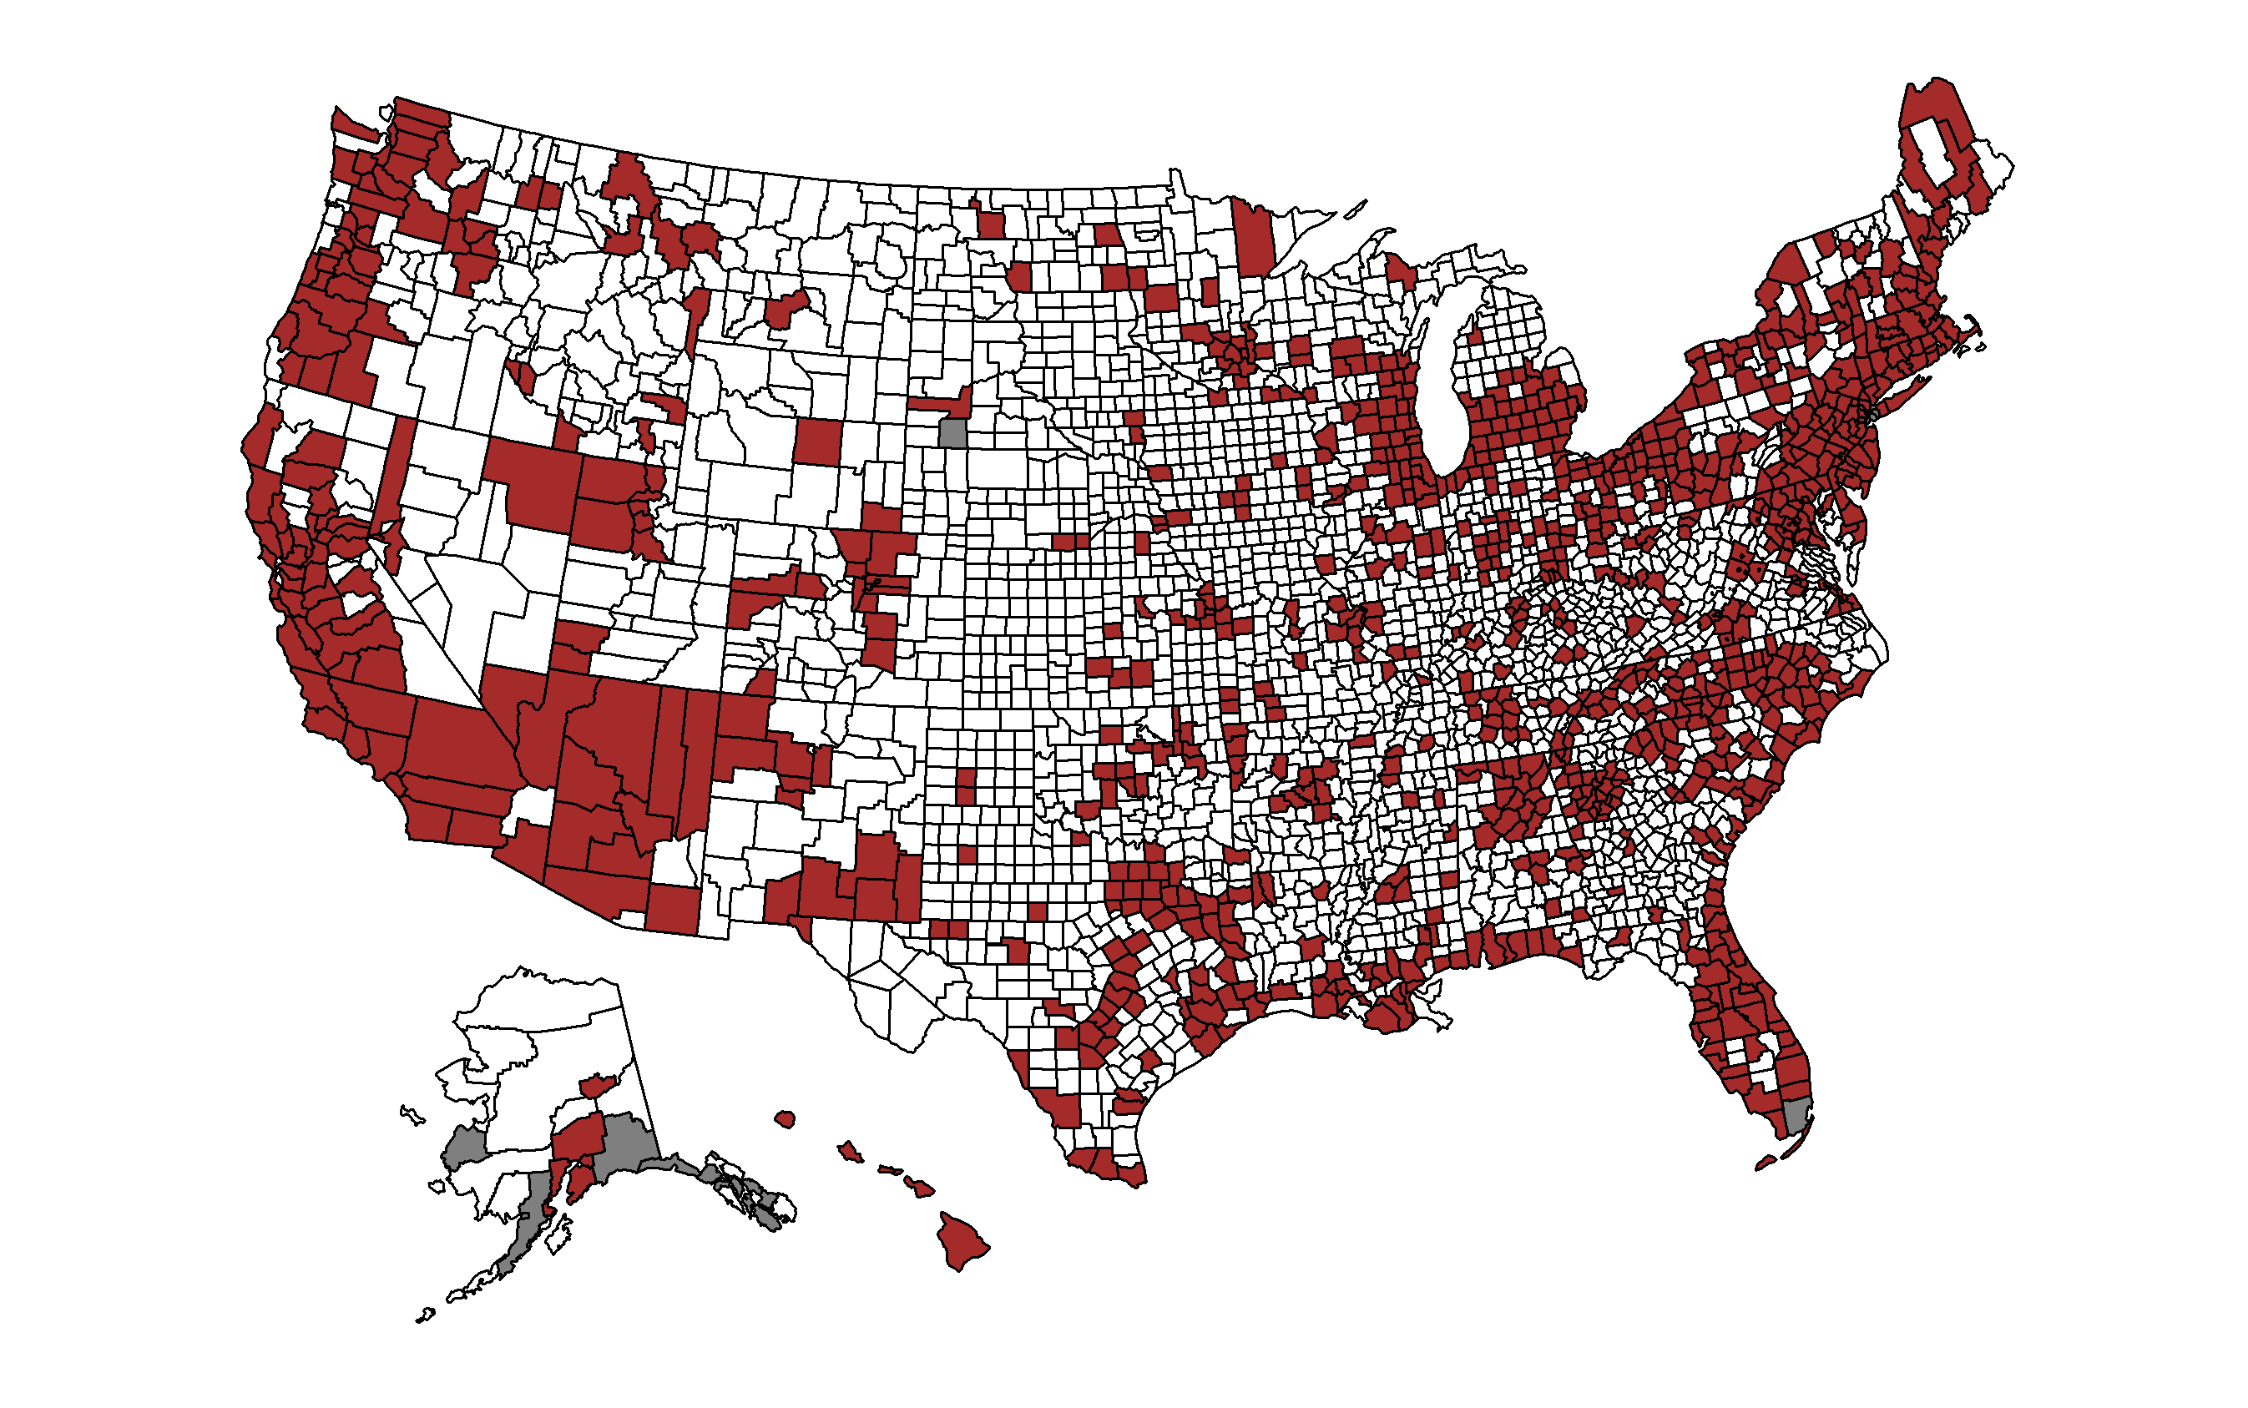
Urban Vs. Rural Classification According to the HRSA

Slide 10
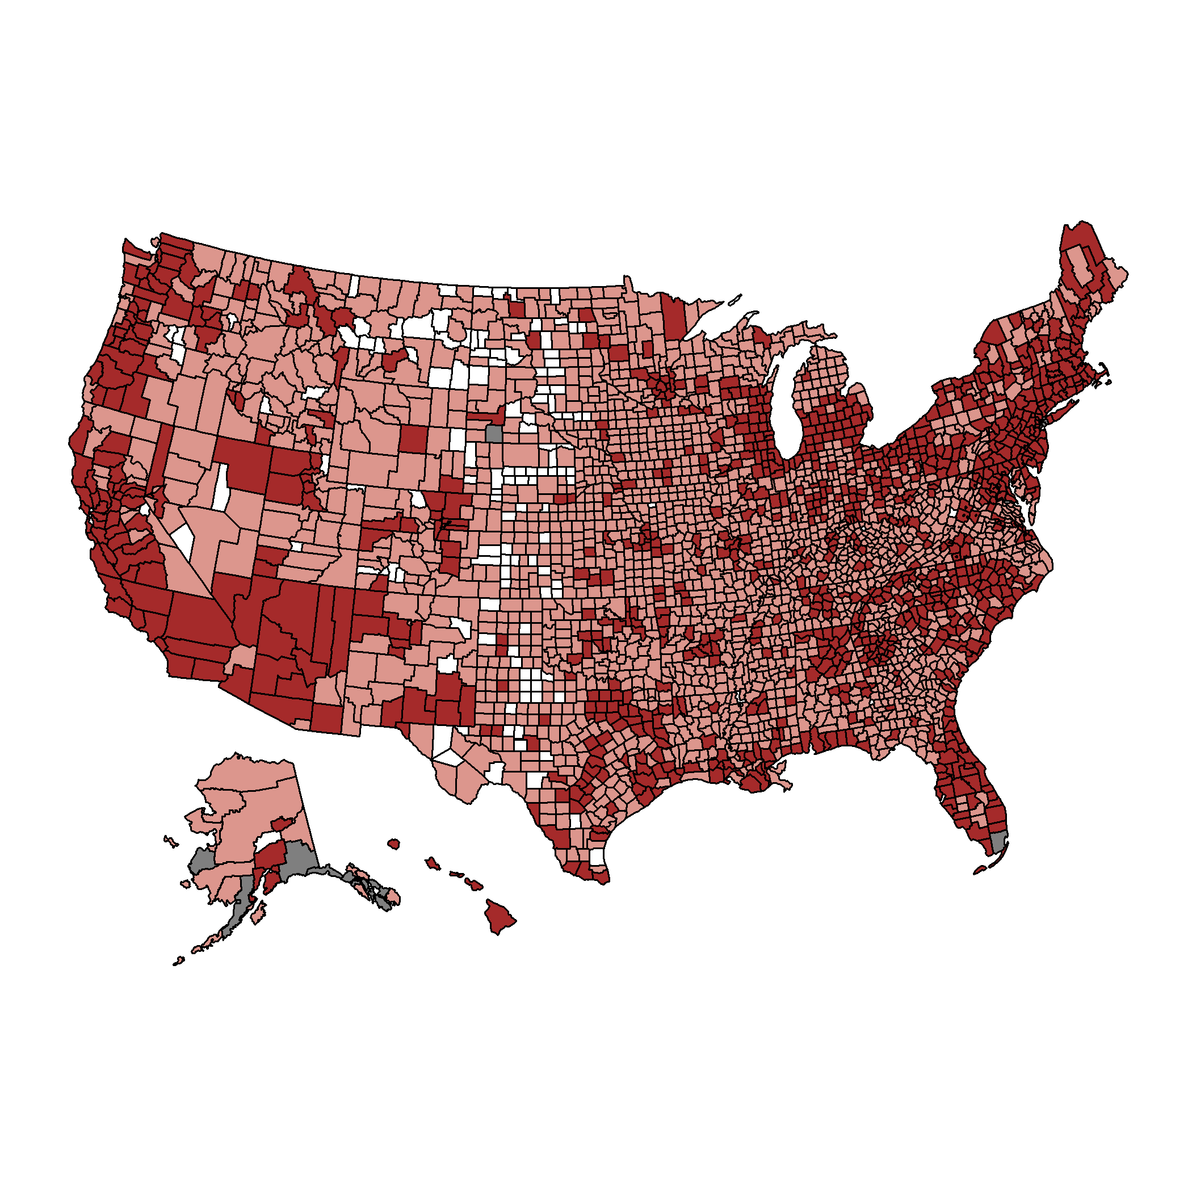
Urban Vs. Rural Classification According to the CDC

Slide 11
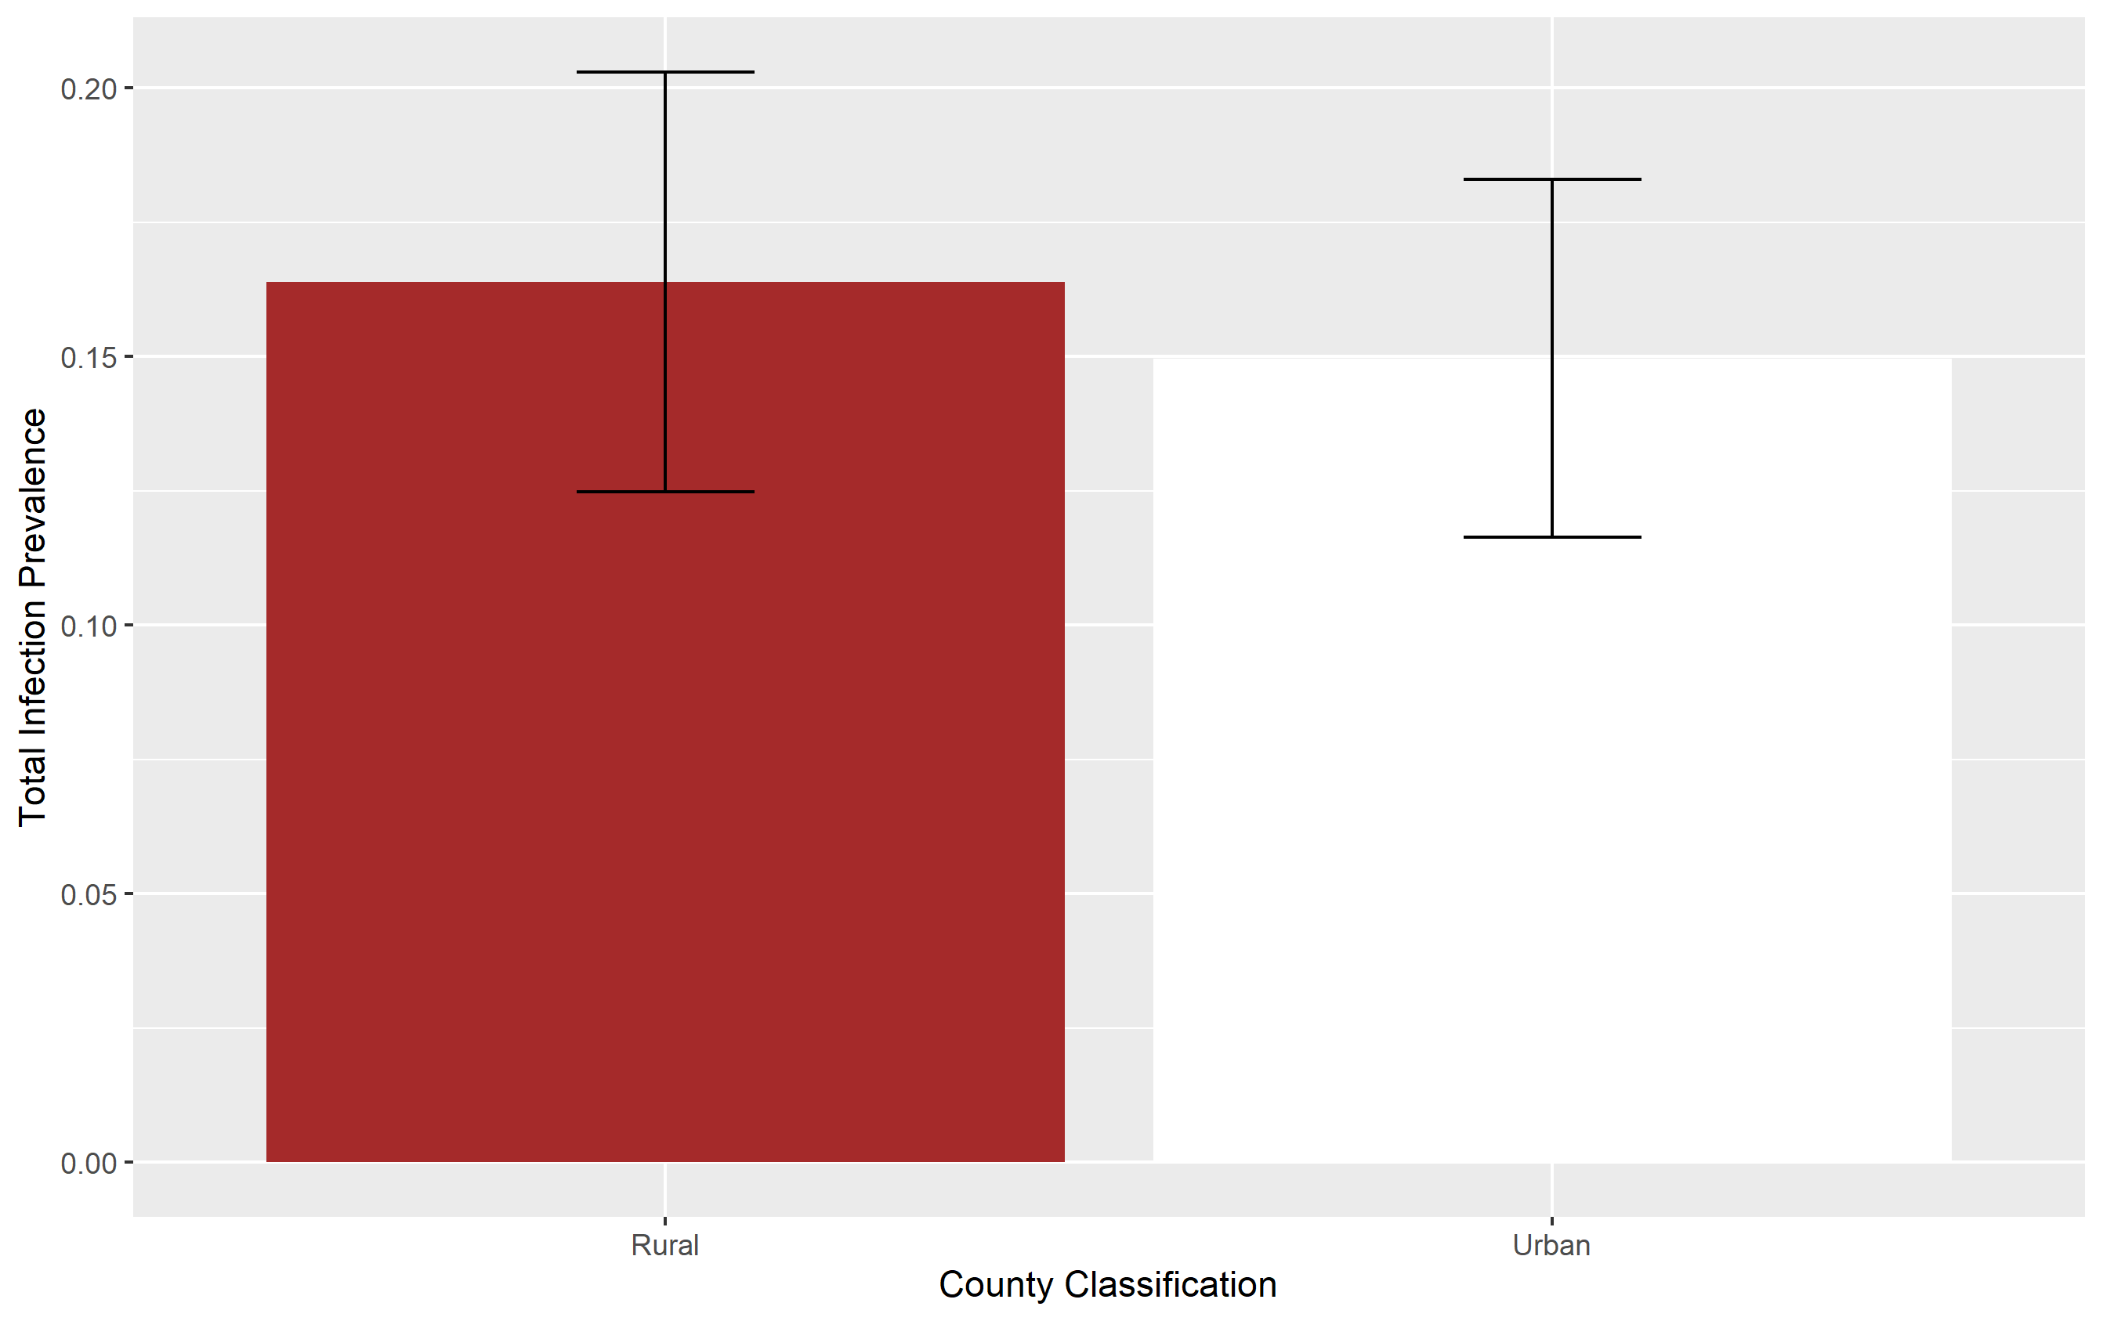
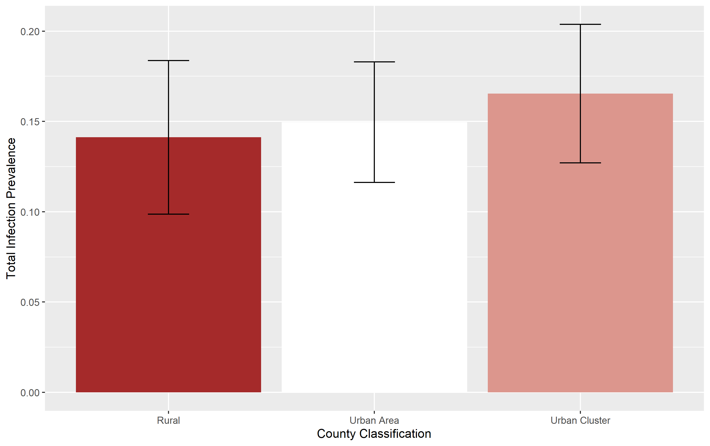

Slide 12
Reproductive Number
R0 – Basic reproductive number
Assumes population has no infections
Expected number of cases generated by one individual
Rt – Effective Reproductive Number
Cases generate at specific time in population

Slide 13
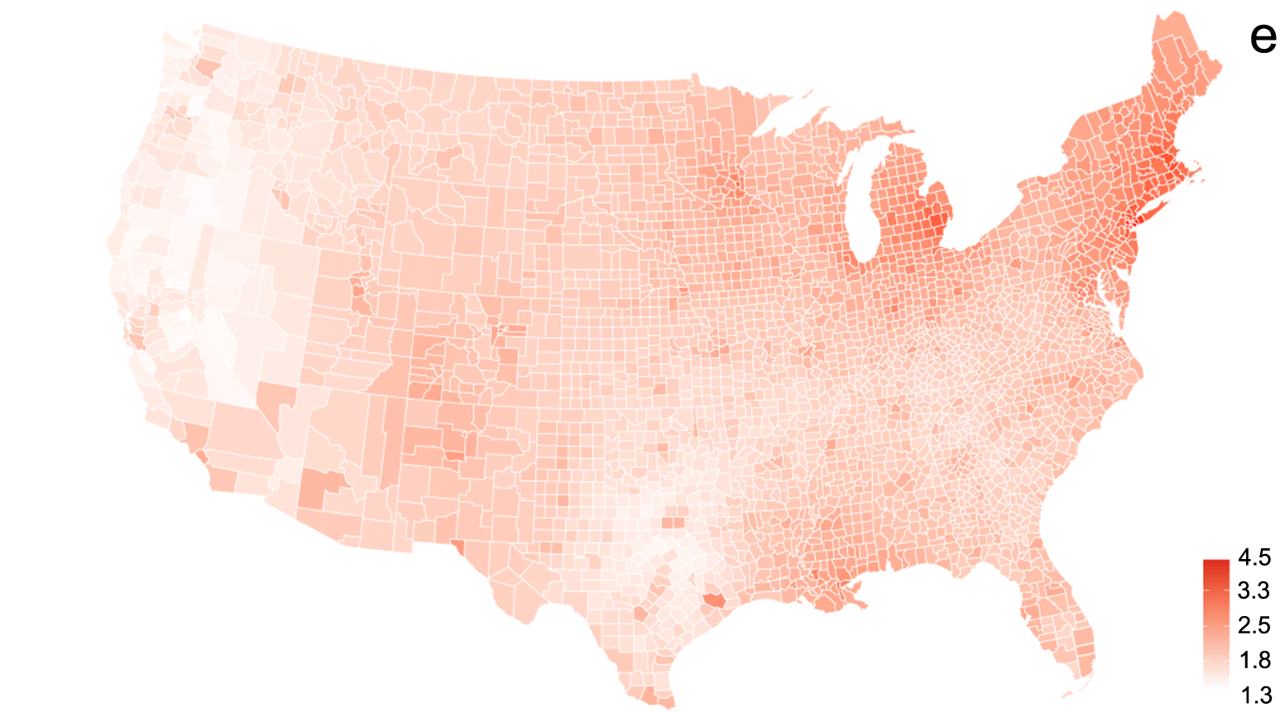
Map of Predicted R0 per County
Ives and Bozzuto 2021

Slide 14
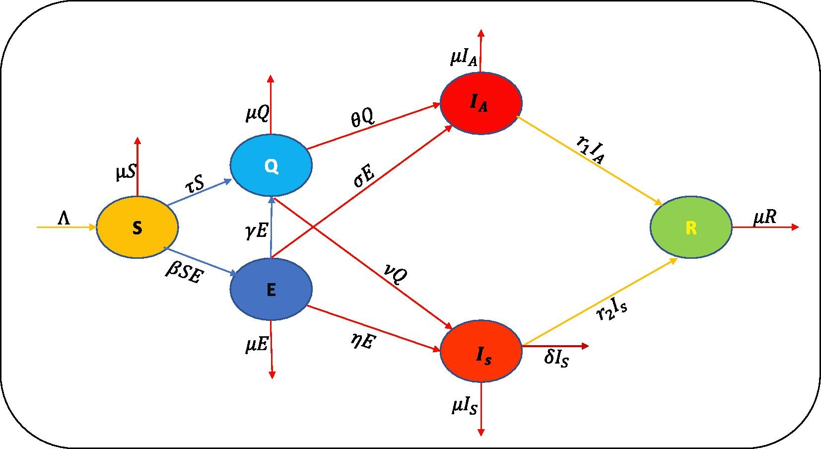
Ahmed et al. 2021

Slide 15
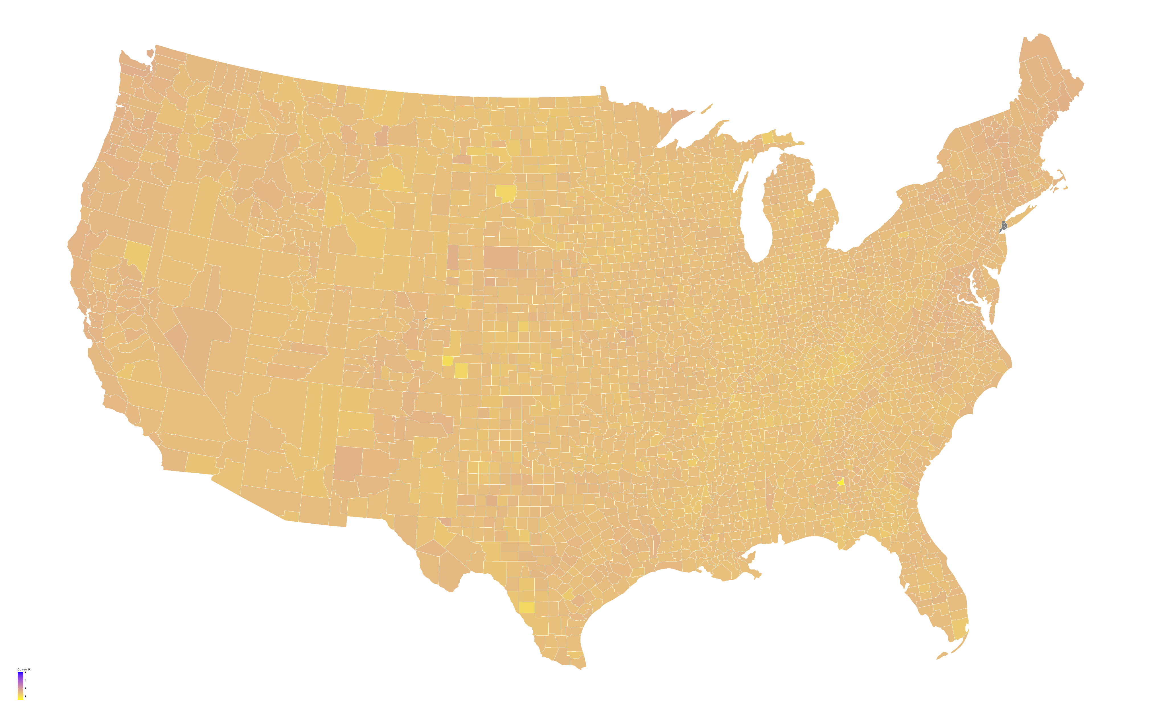
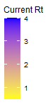
R(t) Values by County

Slide 16
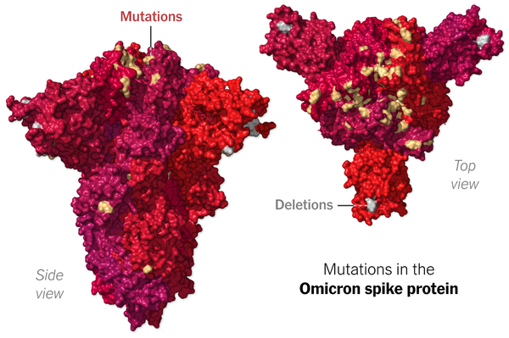
Omicron Variant
Mutation in Spike Proteins
Detected in 15 countries including Canada
NY Times

Slide 17
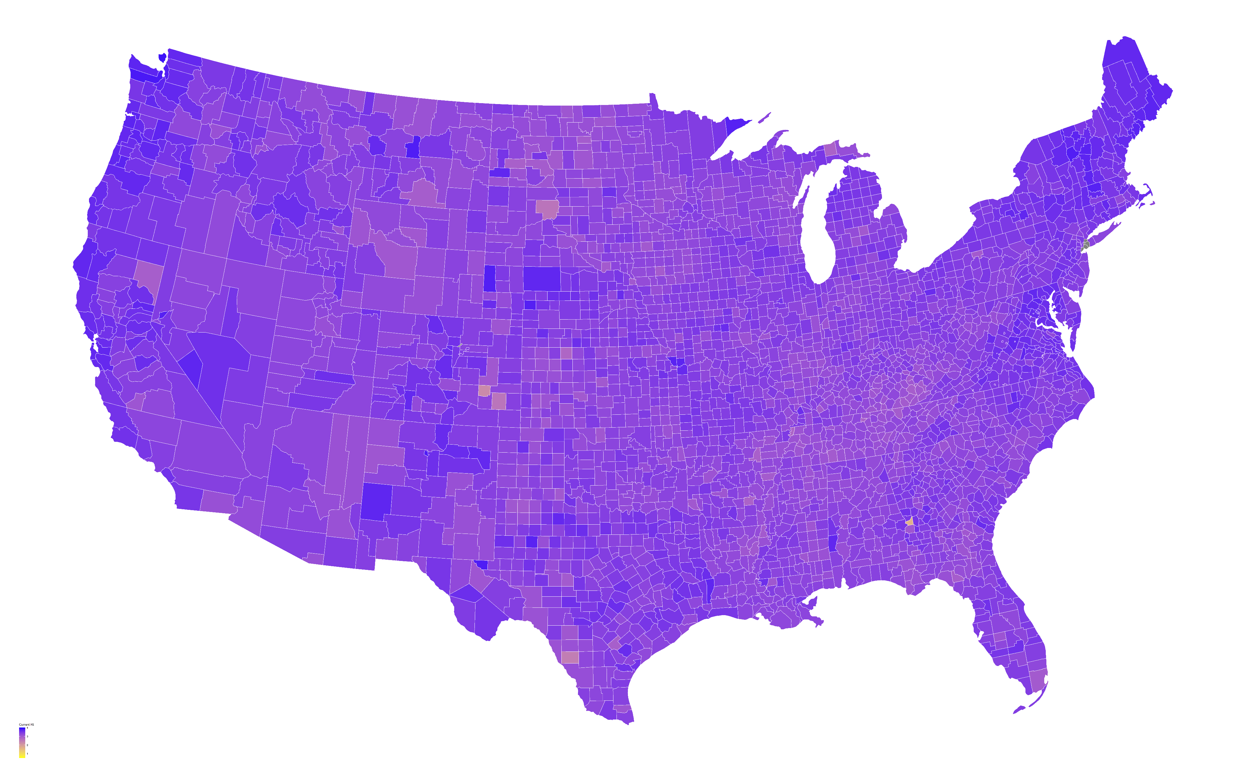

Slide 18
Conclusions
Rural counties are at higher risk for Covid
Mask Mandates do help reduce average spread
Omicron is going to have a drastic effect on Covid-cases

Slide 19
Questions?

